Slide 1
Documenting Software Architectures
Architecture Documentation, Notations, Views, Building the Documentation Package,
Documenting Behaviore, Structure, Quality Attributes, Fast Changing Architectures,
Documenting Architecture in an Agile Development Project

Slide 2
Architecture Documentation
Even the best architecture will be useless if:
  people who need it do not know what it is;
  cannot understand it well enough to use, build, or modify it;
  misunderstand it and apply it incorrectly.
All of the analysis, hard work, and insightful design by an architecture team can be wasted.

Slide 3
Architecture Documentation …
Architecture documentation must
  be sufficiently transparent and accessible to be quickly understood by new employees
  be sufficiently concrete to serve as a blueprint for construction
  have enough information to serve as a basis for analysis.
The documentation is both prescriptive and descriptive.
  For some audiences, it prescribes what should be true, placing constraints on decisions yet to be made.
  For other audiences, it describes what is true, recounting decisions already made about a system’s design.
Understanding stakeholder uses of the documentation is essential to determine the information to capture.

Slide 4
Architecture Documentation …
Three Uses for Architecture Documentation
  Education
    Introducing people to the system
      New members of the team, new architect
      External analysts or evaluators
  Primary vehicle for communication among stakeholders
    Especially architect to developers
    Especially architect to future architect!
  Basis for system analysis and construction
    Architecture tells implementers what to implement.
    Each module has interfaces that must be provided and used from other modules.
    Documentation used for registering and communicating unresolved issues.
    Architecture documentation serves as the basis for architecture evaluation.

Slide 5
Notations
Informal notations
  Views are depicted using general-purpose diagramming and editing tools
  The semantics of the description are characterized in natural language
  They cannot be formally analyzed
Semiformal notations
  Standardized notation that prescribes graphical elements and rules of construction
  Lacks a complete semantic treatment of the meaning of those elements
  Rudimentary analysis can be applied
  UML is a semiformal notation in this sense.
Formal notations
  Views are described in a notation that has a precise (usually mathematically) semantics.
  Formal analysis of both syntax and semantics is possible.
  Architecture description languages (ADLs)
  Support automation through associated tools.

Slide 6
Notations …
Tradeoffs
  More formal notations take more time and effort to create but reduced ambiguity more opportunities for analysis.
  Conversely, more informal notations are easier to create, but they provide fewer guarantees.
Different notations are better (or worse) for expressing different kinds of information.
  UML class diagram not help reason schedulability, sequence chart not tell much about system’s likelihood of timely delivery.
  Choose your notations and representation languages knowing the important issues you need to capture and reason about.
What is UML?
  It’s a general purpose visual modelling language that is used to specify, visualize, construct and document artefacts of a system.

Slide 7
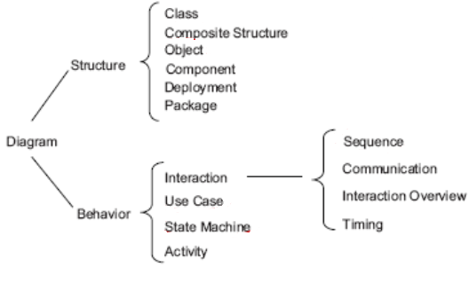
Notations …
UML provides notation to describe object-oriented systems
  De facto standard for OO design, needed at some point in one’s career.
  Parts of UML could be applicable to other programming paradigms.
  Has various versions and UML 2.1 supports 13 kinds of diagrams.

Slide 8
Views
Views let us divide software architecture into a number of manageable representations of the system.
Principle of architecture documentation:
  Documenting an architecture is a matter of documenting the relevant views and things that applies to more than one view.
Different views support different goals and uses.
  The views you should document depend on the uses you expect to make of the documentation.
  Each view has a cost and a benefit; you should ensure that the benefits of maintaining a view outweigh its costs.

Slide 9
Views …
Module Views
  Elements
    Modules are implementation units of software providing coherent set of responsibilities.
  Relations
    Is part of- defines part/whole relationship between submodule and aggregate module.
    Depends on- specifies dependency relationship of two modules views.
    Is a- defines a generalization/specialization relation between more specific (child) and more general (parent) modules.
  Constraints
    Different module views may impose specific topological constraints, such as limitations on the visibility between modules.
  Usage
    Blueprint for construction of the code, change-impact analysis
    Planning incremental development, requirements traceability analysis
    Communicating functionality of a system and structure of its code
    Supporting the definition of work assignments, implementation schedules, and budget information
    Showing structure of information that the system needs to manage
  Complete documentation contains at least one module view.

Slide 10
Views …
Component-connector (C&C) Views
  Elements
    Components. Principal processing units and data stores. A component has a set of ports through which it interacts with other components (via connectors).
    Connectors. Pathways of interaction between components. Connectors have a set of roles (interfaces) that indicate how components may use a connector in interactions.
  Relations
    Attachments. Component ports are associated with connector roles to yield a graph of components and connectors.
    Interface delegation. In some situations component ports are associated with one or more ports in an “internal” subarchitecture. The case is similar for the roles of a connector
  Constraints
    Components are attached to connectors, not to other components.
    Attachments can be made between compatible ports and roles.
    Interface delegation can only be defined between two compatible ports (or two compatible roles).
    Connectors cannot appear in isolation; a connector must be attached to a component.
  Usage
    Show how the system works
    Guide development by specifying structure and behavior of runtime elements.
    Help reason about runtime system quality attributes, such as performance and availability.

Slide 11
Views …
Component-connector (C&C) Views … notations
  UML components are good match for C&C components.
    UML connectors are not rich enough to represent many connectors.
      UML connectors do not have substructure, attributes, or behavioral descriptions.
    Represent a simple connector using a UML connector- a line.
      Many commonly used C&C connectors have well-known, application-independent semantics and implementations, such as function calls or data read operations.
      You can use a stereotype to denote the type of connector.
    Connector roles cannot be explicitly represented with UML connector.
      The UML connector element does not allow the inclusion of interfaces.
      Label the connector ends and use these labels to identify role descriptions that must be documented elsewhere.
    Represent a rich connector using UML component or by annotating a line UML connector with a tag explaining meaning of the complex connector.

Slide 12
Views …
Allocation Views
  Elements
    Software element and environmental element.
    A software element has properties that are required of the environment.
    An environmental element has properties that are provided to the software.
  Relations
    Allocated to. A software element is mapped (allocated to) an environmental element.
    Properties are dependent on the particular view.
  Constraints
    Varies by view
  Usage- reasoning about:
    performance, availability, security, and safety.
    distributed development and allocation of work to teams.
    concurrent access to software versions.
    the form and mechanisms of system installation.

Slide 13
Views …
Quality Views
  Quality view can be tailored to address specific stakeholder concerns.
  It is formed by extracting pieces of structural views and packaging them together.
  Examples:
    Security view
      Show components that have security responsibility, how those components communicate, any data repositories for security information, and repositories that are of security interest.
      The view’s context information can show other security measures (physical) in system’s environment.
      The behavior part of a security view show how operation of security protocols and (where) humans interact with the security elements; and capture how the system would respond to specific threats and vulnerabilities.
    Communications view
      Especially helpful for systems that are globally dispersed and heterogeneous.
      Show all of the component-to-component channels, the various network channels, quality-of-service parameter values, and areas of concurrency.
      Used to analyze performance and reliability (such as deadlock or race condition detection).
      The behavior part of this view could show how network bandwidth is dynamically allocated.

Slide 14
Views …
Quality Views …
  Examples …
    Exception or error-handling view
      Could help illuminate and draw attention to error reporting and resolution mechanisms.
      Show how components detect, report, and resolve faults or errors.
      It would help identify the sources of errors and appropriate corrective actions for each.
    Reliability view
      Models mechanisms such as replication and switchover.
      Depicts timing issues and transaction integrity.
    Performance view
      Shows those aspects of the architecture useful for inferring the system’s performance.
      Show network traffic models, maximum latencies for operations, and so forth.

Slide 15
Views …
Choosing the Views
  Determining which views are required, when to create them, and level of detail to include.
  Need to know the following:
    Available people and their skills, standards to comply with, budget is on hand, schedule
    Information needs of the stakeholders, driving quality attribute requirements
    Approximate size of the system
  Have the below in architecture document:
    At least- one module view, one C&C view, and for larger systems one allocation view.

Slide 16
Views …
Choosing the Views … method
  Step 1. Build a stakeholder/view table.
    Rows- list stakeholders for architecture documentation
    Columns- enumerate the views that apply to your system, include view sketches resulting from design work so far.
    Cells- describe level of information detail stakeholder requires from view: none, overview, moderate, or high.
  Step 2. Combine views to reduce their number
    Look for marginal views in the table requiring an overview, or that serve very few stakeholders.
    Combine each marginal view with another view that has a stronger constituency like various C&C views, deployment view with SOA, decomposition and layered views.
  Step 3. Prioritize and stage.
    The decomposition view is a particularly helpful view to release early.
    You don’t have to satisfy information needs of all stakeholders to the fullest.
    You don’t have to complete one view before starting another.
Notes:
Step 1. Build a stakeholder/view table.
Rows- list stakeholders for architecture documentation
Columns- enumerate the views that apply to your system, include view sketches resulting from design work so far.
Some views like decomposition, uses, and work assignment apply to every system
Other views like layered view only apply to some systems.
In each cell, describe level of information detail stakeholder requires from view: none, overview, moderate, or high.
Step 2. Combine views to reduce their number
Look for marginal views in the table; those that require only an overview, or that serve very few stakeholders.
Combine each marginal view with another view that has a stronger constituency.
These views often combine naturally:
Various C&C views. Because C&C views all show runtime relations among components and connectors of various types, they tend to combine well.
Deployment view with either SOA or communicating-processes views. An SOA view shows services, and a communicating-processes view shows processes. In both cases, these are components that are deployed onto processors.
Decomposition view and any of work assignment, implementation, uses, or layered views. The decomposed modules form the units of work, development, and uses. In addition, these modules populate layers.
Step 3. Prioritize and stage.
The decomposition view (one of the module views) is a particularly helpful view to release early.
High-level decompositions are often easy to design
The project manager can start to staff development teams, put training in place, determine which parts to outsource, and start producing budgets and schedules.
You don’t have to satisfy all the information needs of all the stakeholders to the fullest extent.
Providing 80 percent of the information goes a long way, and this might be “good enough” so that the stakeholders can do their job.
Check with the stakeholder if a subset of information would be sufficient.
You don’t have to complete one view before starting another.
People can make progress with overview-level information
A breadth-first approach is often the best.

Slide 17
Building the Documentation Package
Documentation package consists of
  Views
  beyond views
View Template

Slide 18
Building the Documentation Package …
Documenting a View
  Section 1: The Primary Presentation.
    The primary presentation shows the elements and relations of the view.
    It should contain information needed to convey about the system—in the vocabulary of that view.
    It is most often graphical or textual
  Section 2: The Element Catalog.
    Element catalog details at least elements depicted in the primary presentation.
    Parts of the catalog are- elements and their properties, relations and their properties, element interfaces, element behavior.
  Section 3: Context Diagram.
    Used to depict the scope of a view where entities in the environment may be humans, computer, sensors, etc.
  Section 4: Variability Guide.
    Shows how to exercise any variation points that are a part of the architecture.
  Section 5: Rationale.
    To explain why the design is as it is and to provide a convincing argument that it is sound like choice of a pattern.
Notes:
Section 1: The Primary Presentation.
The primary presentation shows the elements and relations of the view.
The primary presentation should contain the information you wish to convey about the system—in the vocabulary of that view.
The primary presentation is most often graphical.
It might be a diagram you’ve drawn in an informal notation using a simple drawing tool, or it might be a diagram in a semiformal or formal notation imported from a design or modeling tool that you’re using.
If your primary presentation is graphical, make sure to include a key that explains the notation.
Lack of a key is the most common mistake that we see in documentation in practice.
Occasionally the primary presentation will be textual, such as a table or a list.
If that text is presented according to certain stylistic rules, these rules should be stated or incorporated by reference, as the analog to the graphical notation key.
Section 2: The Element Catalog.
The element catalog details at least those elements depicted in the primary presentation.
For instance, if a diagram shows elements A, B, and C, then the element catalog needs to explain what A, B, and C are.
If elements or relations relevant to this view were omitted from the primary presentation, they should be introduced and explained in the catalog.
Parts of the catalog:
Elements and their properties. This section names each element in the view and lists the properties of that element. Each view introduced in Chapter 1 listed a set of suggested properties associated with that view.
Relations and their properties. Each view has specific relation types that it depicts among the elements in that view.
Element interfaces. This section documents element interfaces.
Element behavior. This section documents element behavior that is not obvious from the primary presentation.
Section 3: Context Diagram.
A context diagram shows how the system or portion of the system depicted in this view relates to its environment.
The purpose of a context diagram is to depict the scope of a view.
Entities in the environment may be humans, other computer systems, or physical objects, such as sensors or controlled devices.
Section 4: Variability Guide.
A variability guide shows how to exercise any variation points that are a part of the architecture shown in this view.
Section 5: Rationale.
Rationale explains why the design reflected in the view came to be.
The goal of this section is to explain why the design is as it is and to provide a convincing argument that it is sound.
The choice of a pattern in this view should be justified here by describing the architectural problem that the chosen pattern solves and the rationale for choosing it over another.

Slide 19
Building the Documentation Package …
Documenting Information Beyond Views
  Document control information.
    List the issuing organization, current version number, date of issue and status, change history, and procedure for submitting change requests to document.
  Section 1: Documentation Roadmap-
    Tells reader what information is in the documentation and where to find it.
    Scope and summary, how the documentation is organized, view overview, how stakeholders can use the documentation.
  Section 2: How a View Is Documented.
    Explain the standard organization you’re using to document views—either the one described in this chapter or one of your own.
  Section 3: System Overview.
    Short prose description of the system’s function, its users, and any important background or constraints.
    Provides your readers with a consistent mental model of the system and its purpose.
    This might be a pointer to your project’s concept-of-operations document for the system.
Notes:
Document control information.
List the issuing organization, the current version number, date of issue and status, a change history, and the procedure for submitting change requests to the document.
Usually captured in the front matter
Section 1: Documentation Roadmap. The documentation map tells the reader what information is in the documentation and where to find it.
Scope and summary. Explain the purpose of the document and briefly summarize what is covered.
How the documentation is organized. For each section in the documentation, give a short synopsis of the information that can be found there.
View overview. Describes the views that the architect has included in the package. For each view::
The name of the view and what pattern it instantiates, if any.
A description of the view’s element types, relation types, and property types.
A description of language, modeling techniques, or analytical methods used in constructing the view.
How stakeholders can use the documentation.
This section shows how various stakeholders might use the documentation to help address their concerns.
Include short scenarios, such as “A maintainer wishes to know the units of software that are likely to be changed by a proposed modification.”
To be compliant with ISO/IEC 42010-2007, you must consider the concerns of at least users, acquirers, developers, and maintainers.
Section 2: How a View Is Documented.
Explain the standard organization you’re using to document views—either the one described in this chapter or one of your own.
Section 3: System Overview.
Short prose description of the system’s function, its users, and any important background or constraints.
Provides your readers with a consistent mental model of the system and its purpose.
This might be a pointer to your project’s concept-of-operations document for the system.

Slide 20
Building the Documentation Package …
Documenting Information Beyond Views …
  Section 4: Mapping Between Views.
    Helping a reader understand the associations between views will help that reader gain a powerful insight into how the architecture works as a unified conceptual whole.
    Associations between elements across views are, in general, many-to-many.
    View-to-view associations can be captured as tables.
  Section 5: Rationale.
    Documents architectural decisions that apply to more than one view.
    Documentation of background or organizational constraints, decisions about which fundamental patterns are used.
  Section 6: Directory.
    Set of reference material that helps readers find information quickly- index of terms, glossary, acronym list.
Notes:
Section 4: Mapping Between Views.
Helping a reader understand the associations between views will help that reader gain a powerful insight into how the architecture works as a unified conceptual whole.
The associations between elements across views in an architecture are, in general, many-to-many.
View-to-view associations can be captured as tables.
The table should name the correspondence between the elements across the two views.
Examples
“is implemented by” for mapping from a component-and-connector view to a module view
“implements” for mapping from a module view to a component-and-connector view
“included
Section 5: Rationale.
Documents the architectural decisions that apply to more than one view.
Documentation of background or organizational constraints or major requirements that led to decisions of system-wide import.
Decisions about which fundamental architecture patterns are used.
Section 6: Directory.
Set of reference material that helps readers find more information quickly.
Index of terms
Glossary
Acronym list.

Slide 21
Documenting Behavior
Behavior documentation complements each views by describing how architecture elements in that view interact with each other.
Behavior documentation enables reasoning about
  a system’s potential to deadlock
  a system’s ability to complete a task in the desired amount of time
  maximum memory consumption
  and more
Behavior has its own section in our view template’s element catalog.

Slide 22
Notations for Documenting Behavior
Trace-oriented languages
  Traces are sequences of activities or interactions between structural elements in response to a specific stimulus of a specific system’s state.
  Examples
    use cases
    sequence diagrams
    communication diagrams
    activity diagrams
    message sequence charts
    timing diagrams
    Business Process Execution Language
Comprehensive languages
  This models show complete behavior of structural elements.
  Such models enable to infer possible paths from initial to final state- state machine.

Slide 23
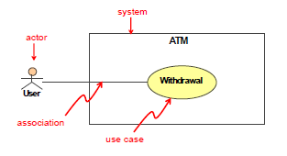
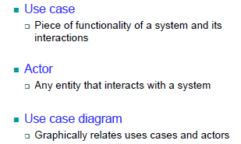
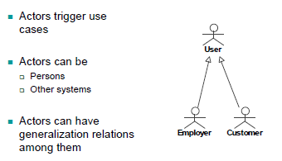
Use cases
Use cases
  Use case modelling consists of UML use case diagrams and textual description of a system
  The main goals is to elicit stakeholder requirements and provide a foundation for developers to further analyse and implement a system
Use case diagrams
More on actors

Slide 24
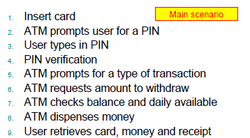
Use cases …
Scenarios
  What is a use case scenario?
    A use case scenario is an instance of a use case.
    It is an execution path of a use case.
    It is an example of a transaction in a use case.
  Examples. ATM withdrawal
    Successful withdrawal
    PIN is incorrect
    Not enough funds
    Not enough notes in the ATM
Example scenario

Slide 25
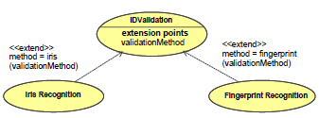
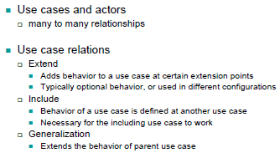
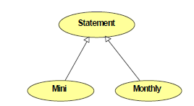
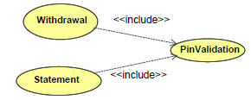
Use cases …
Use case diagrams …
Extend relationship
Generalisation relationship
Textual description
  Not part of UML definition
  Methodology and tool dependent
  Relies on natural language
Include relationship

Slide 26
Use cases …
Use case diagrams and description- an example case - call
From Documenting Software Architectures: Views and Beyond, 2nd edition, Addison Wesley, 2010

Slide 27

Sequence Diagrams
Sequence diagram
  Shows how objects collaborate to implement some behavior in time
  Typically represent a single scenario
  It has two dimensions: horizontal (objects that collaborate) and vertical (message sequences over time)
Some types of messages
  Call -An action in which a stimulus is created that causes an operation to be invoked in the receiver
  Return- An action that returns a value to a caller
  Create- An action in which an instance is created based on the definition of the specified classifier

Slide 28
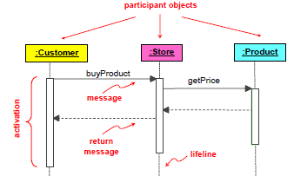


Sequence Diagrams …
Some types of messages …
  Destroy- Action of an instance causes another instance to cease exist
  Synchronous- The caller waits for the completion of the operation.
  Create- The caller does not wait for the operation to complete, but instead proceeds immediately
  Messages can- be numbered, pass parameters, and be self-referential
Sequence Diagram Example
Pass parameters
Self-referential
Destroy
Create
Synchronous
Numbered

Slide 29
Sequence Diagram …
Sequence Diagram - an example case - call

Slide 30
Communication Diagram
Communication Diagram
  Extension of object diagram- exchange of messages between objects.
  Communication Diagram - an example case - call
Source: Documenting Software Architectures: Views and Beyond, 2nd edition, Addison Wesley, 2010

Slide 31
Activity Diagram
Activity Diagram
  It shows steps performed in use case
  Paves business process
  Models software elements, e.g., methods
Source: Documenting Software Architectures: Views and Beyond, 2nd edition, Addison Wesley, 2010

Slide 32
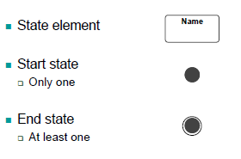
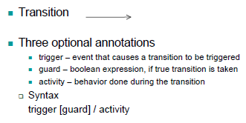
State Machine
Description
  State machine (comprehensive) languages complement structural description of the elements with constraints on interactions and timed reactions to stimuli.
  Purpose
    shows how an object changes states throughout its life based on previous states and events
    contains a start state and at least one end state
  State- set of attribute values
  Transition- change from a state to another based on some conditions and events that may produce some activities
  Event- anything that causes a transition
  Notations:

Slide 33
State Machine …
From Documenting Software Architectures: Views and Beyond, 2nd edition, Addison Wesley, 2010

Slide 34
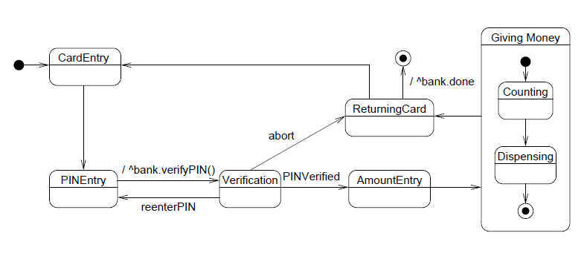
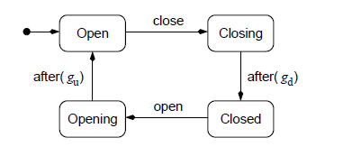
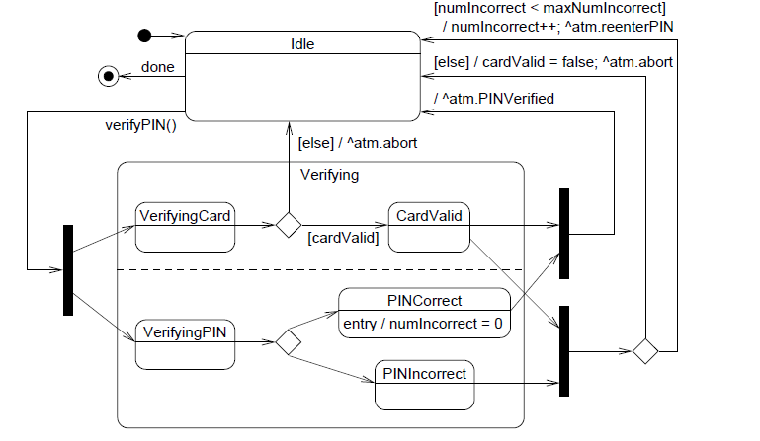
State Machine …
State machine example (Gate)
State machine example (ATM)
State machine example – more detailed (ATM)

Slide 35
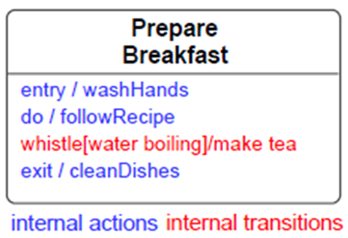
State Machine …
A state can have:
  Internal actions
    entry: always occurs when a state is entered
    exit: always occurs when a state is left
    do: ongoing process while on the state
  Internal transitions
    event [condition]/action
  Nested states
State machine diagrams
  Can be only in one state at any given time
  When one transition is fired- machine moves to next state.
  If an event happens at a state that does not have a transition for it the event is ignored- this could be a sign of a bad design

Slide 36
More on documenting
Ways to show up quality attributes in the documentation:
  Rationale that explains the choice of design approach should include a discussion about the quality attribute requirements and tradeoffs.
  Architectural elements providing service have quality bounds assigned to them, documented in interfaces or as properties of elements.
  Fluency in “language” of a quality attribute enables searching for architectural elements to satisfy the required attributes.
  Architecture documentation has a mapping to requirements that shows how requirements (quality attribute) are satisfied.
  Every quality attribute requirement has stakeholders who want to know if it is satisfied- roadmap to find it in document.

Slide 37
More on documenting …
Documenting frequently changing architectures
  Architecture changes at runtime, or high release-and-deploy cycle, change much faster than the documentation cycle.
  No one waits until new document is produced, reviewed and released- in such a case:
    Document what is true about all versions of your system- record those invariants as you would for any architecture.
    Document the ways the architecture can change (variability guide)- how to add new or replace components.
Notes:
Documenting frequently changing architectures
Architecture changes at runtime, or high release-and-deploy cycle, change much faster than the documentation cycle.
No one waits until new document is produced, reviewed and released- in such a case:
Document what is true about all versions of your system. Record those invariants as you would for any architecture. This may make your documented architecture more a description of constraints or guidelines that any compliant version of the system must follow.
Document the ways the architecture is allowed to change. This will usually mean adding new components and replacing components with new implementations. The place to do this is called the variability guide.

Slide 38
More on documenting …
Documenting architecture in an Agile project
  Adopt a template or standard organization to capture your design decisions.
  Document a view only if it has a strongly identified stakeholder.
  Fill in the sections of the template for a view, and for information beyond views- if this information is relevant for downstream team.
  Don’t worry about creating an architectural design document- produce just enough design information to allow to move on to code.
  Don’t feel obliged to fill up all sections of the template- write N/A for sections which you don’t need to record the information.
  Agile teams sometimes make models in brief discussions by the whiteboard- take a picture and use it as the primary presentation.

Slide 39
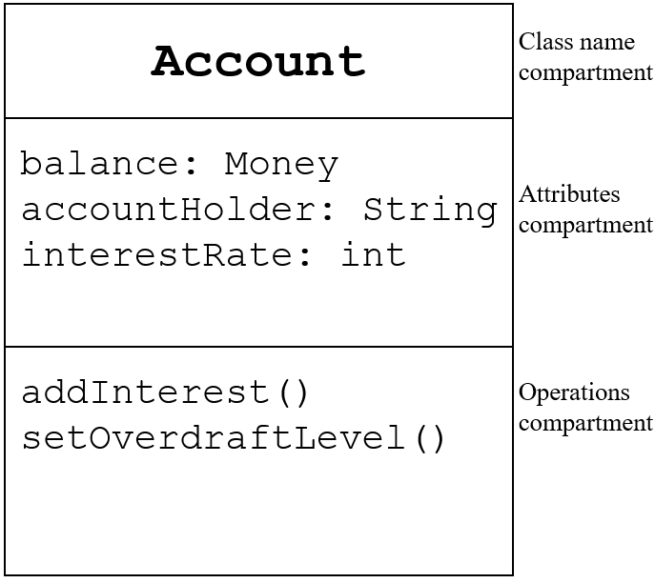

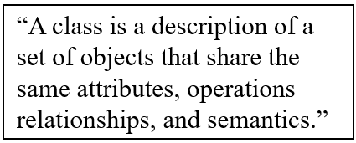
Documenting Structure
UML structural diagrams depict the elements of a system that are independent of time.
The elements in these diagrams represented as nouns and have structural or semantic relationships.
Class diagrams- describe the types of objects in a system and the relationships among them- class structure has:
  Name
  Fields
  Methods/operations
Notes:
Modifiers (or access privileges in Java)
public members
referenced from anywhere
UML denotes with +
private members
referenced in instances of the class that declares them
UML denotes with -
protected members
referenced in subclasses and classes in same package
UML denotes with #
default members also known as package privilege
Referenced in classes in the same package
UML denotes with ~

Slide 40
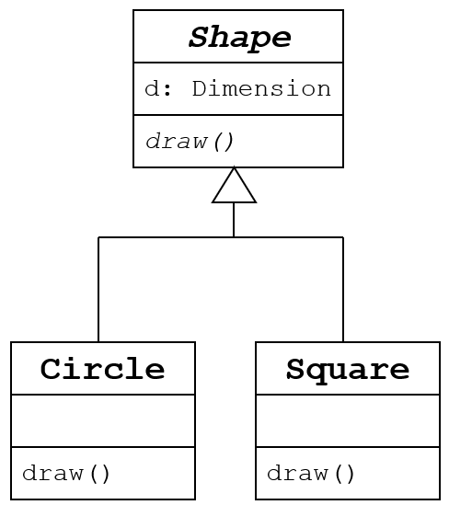
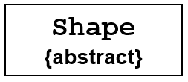
Documenting Structure …
Class diagrams …
  Abstract classes- have incomplete definition
  They are template classes
  They are meant to be sub-classed
  In UML:
    Class name in italics
    Method name in italics
    Add {Abstract} to name compartment

Slide 41
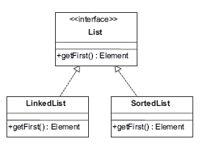
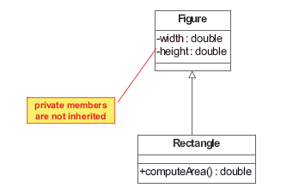
Documenting Structure …
Class diagrams …
  Interface defines a set of methods and fields- classes provide implementation for all the methods in the interface
  Relationships- generalization, association, aggregation, composition
  Generalization
    Taxonomic relationship between general description and specific (that extends).
    It relates to inheritance and is denoted with an arrow line with an empty arrowhead from subclass to superclass
Interface
Generalisation example

Slide 42
Documenting Structure …
Class diagrams …
  Generalization …
    Name – Optional
      Related to problem domain
      Typically a verb
    Navigability
      Establishes the direction of the relation
      Denoted with a filled arrow head
      Can be bidirectional
    Multiplicity
      Establishes how many objects participate in the relation
      Typical: 0, 1, 0..1, 1..*, *
      Default: 1
  Association
    Connections between two classes
    implies a connection of instances of both classes
      class X uses/references/knows class Y
    Denoted in UML with a solid line
    Example: A Person owns zero or more Pets

Slide 43
Documenting Structure …
Class diagrams …
  Aggregation
    Specialized case of association
    Describes a whole-part relationship between classes
      Whole – aggregate
      Part – constituent
    Aggregation characteristics
      Aggregate can exists without parts
      An object can belong to more than one aggregate
      Constituents tend to be of the same class
    Aggregation example- An university is comprised of many colleges

Slide 44
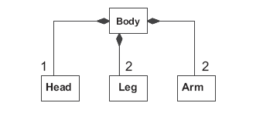
Documenting Structure …
Class diagrams …
  Composition
    Specialized case of association
      Stronger form of ownership than aggregation
        Objects have same life time
    Describes a whole-part relationship between classes
      Whole – composite
      Part – component
    Composition characteristics
      Composite cannot exist without its components
      An object can belong to only one component
      Components tend to be of different classes
    Composition Example- A human body is composed of 1 head, 2 arms and 2 legs

Slide 45

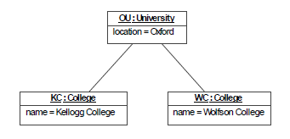
Documenting Structure …
Object Diagrams
  Object Diagrams are snapshots of the objects in a system at a given time
    Useful to illustrate complex relations among objects
  Object element:
  Example Object Diagram

Slide 46
Mapping to Code
There is no a one-one mapping from UML to any OO language
UML was designed to be language independent
Examples of mappings for particular cases in Java- do not constitute a generalization
Mapping- generalisation example

Slide 47
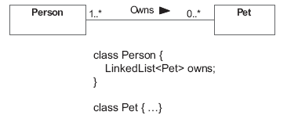
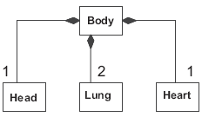
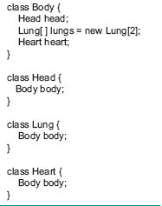
Mapping to Code …
Association example- add cardinality- provide a runtime mechanism to enforce it!
Aggregation example
Composition example

Slide 48
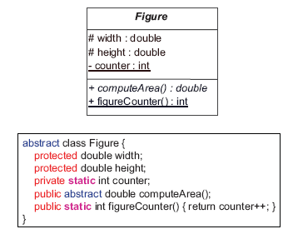
Mapping to Code …
Abstract classes
Static members
Interfaces

Slide 49
Summary
Understand audience of architecture document is written for.
The documentation serves as a means for communication among stakeholders- management, developers, etc.
Architecture is complex artifact- express focusing on views.
Choose (minimal/adequate) views to document and notation.
Document both structure and behavior of the architecture

